Slide 1
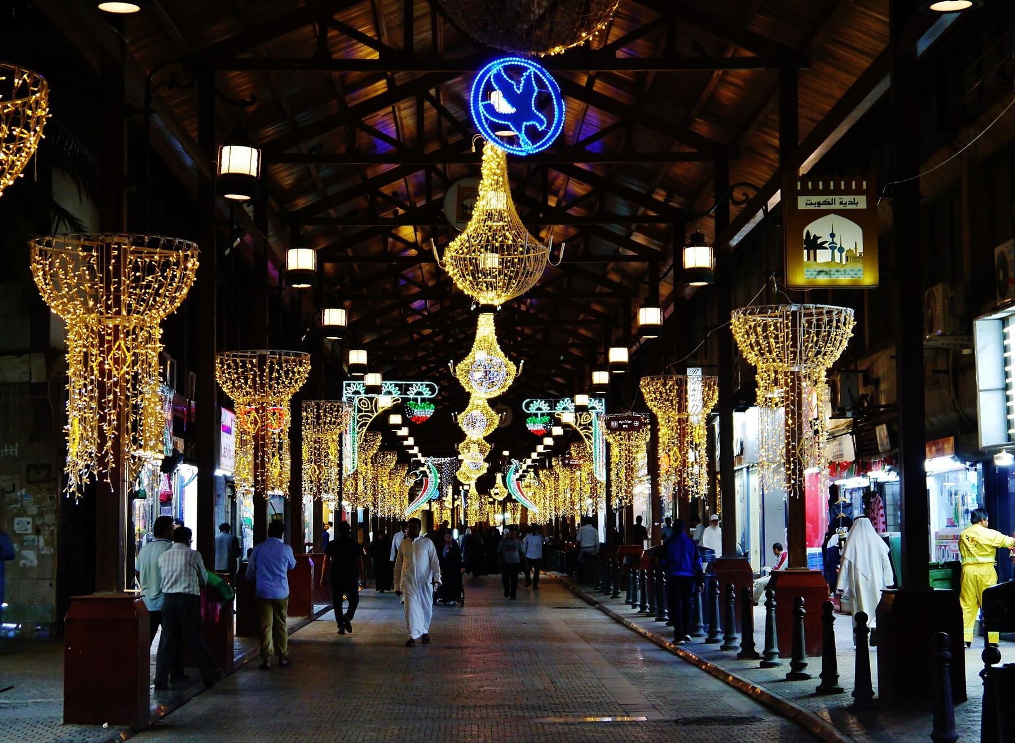
Ali AlEnezi · Site@hotmail.com · 3li.info
A VISION BY ALI ALENEZI · KUWAIT CITY
Smart Souq Al-Mubarakiya
This is my dream for Al-Mubarakiya, and I wanted to share it with everyone: that the souq stays as we know and love it, with its soul and its history, and becomes safer through smart technology that works in silence.
Sensors nobody notices, an edge that keeps the fire alarm working when the cloud does not, a digital twin built on the map, and trust zones around all of it.
A personal vision, shared to read and discuss. · mubarakiya.3li.info
This work is part of an educational experience. The ideas are owned by Ali AlEnezi. The entities mentioned, Kuwait Municipality, the Ministry of Interior, Kuwait Fire Force, NCCAL, CITRA, the Ministry of Electricity and Water, the Ministry of Commerce, the merchants, and SANS, are mentioned only to elaborate on the ideas and have no real link or connection to this work. SANS is named only as a suggestion for training, and none of its copyrighted material is used here. © 2026 Ali AlEnezi. All rights reserved.
Notes:
Open with the dream. Make clear this is a personal vision, shared to read.

Slide 2
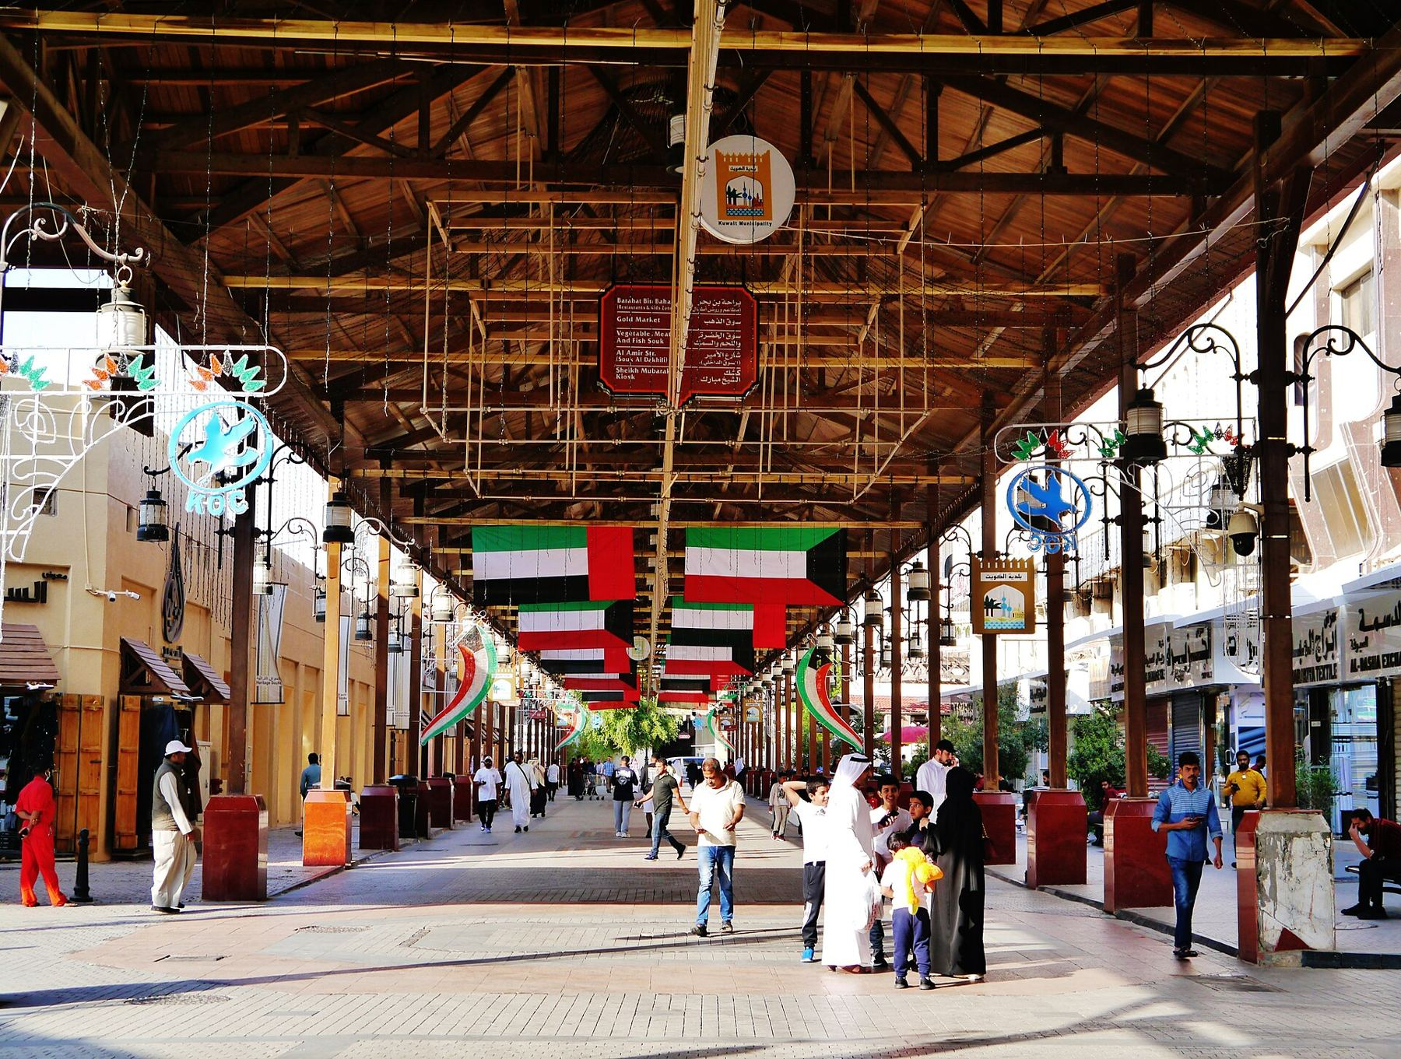





Ali AlEnezi · Site@hotmail.com · 3li.info
01 // WHY THIS SOUQ
Two centuries old, pedestrian, dense, and loved
Heritage
Nothing drilled into historic facades. Sensors on lamp posts, awnings, and municipal fixtures. NCCAL signs off first.
Climate
50 C summers and dust storms. Every device rated 60 C or better and IP65 or better, solar where wiring is forbidden.
Life safety first
Narrow alleys, wooden roofs, dense restaurants, peak crowds. Fire and crowd safety are use case number one.
Many owners
Municipality, MOI, Kuwait Fire Force, NCCAL, CITRA, MEW, Commerce, and the merchants. Governance is half the project.
Privacy
Count people, never identify them. No facial recognition, anonymized counting at the edge, signage in the souq.
Smart Souq Al-Mubarakiya · a vision by Ali AlEnezi
Notes:
Set the scene: heritage first, life safety first, then technology.

Slide 3
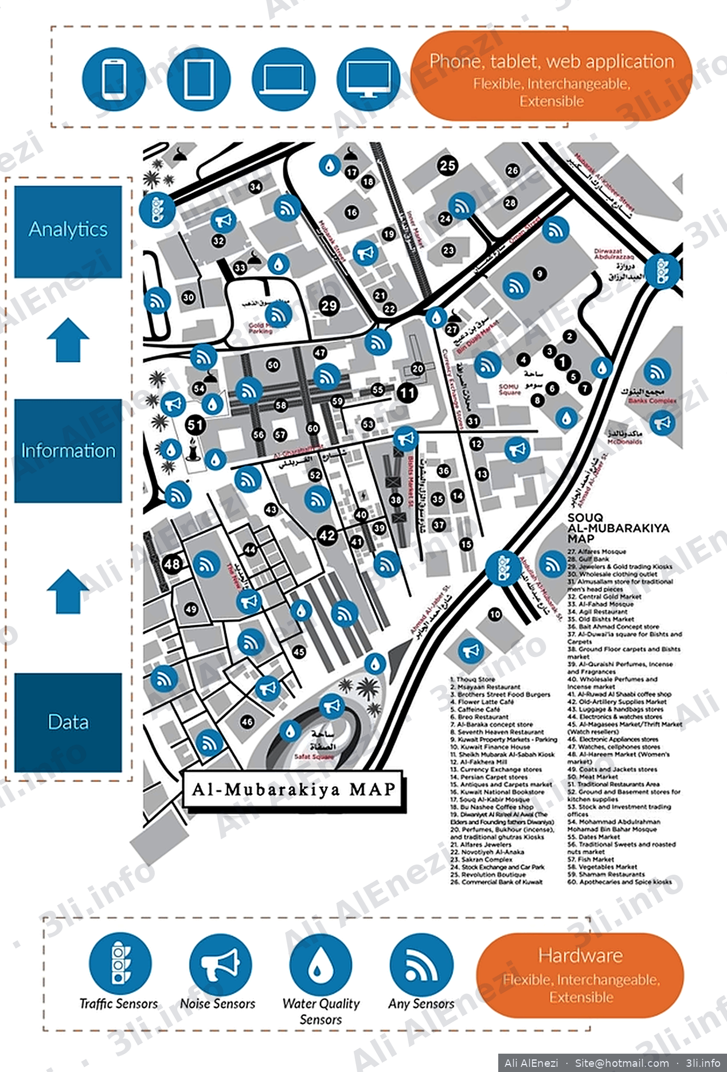
Ali AlEnezi · Site@hotmail.com · 3li.info
02 // THE MAP
The numbered map is the digital twin
67
9
REGISTRY ENTRIES
ZONES
14
37
SENSOR CLASSES
PLACED SENSORS
Every location becomes an ID MUB-Z4-057-WATER-01 is the water quality probe at the fish market, zone Z4.
Every device publishes a signed envelope on mubarakiya/Z4/057/WATER/<device>/telemetry, and the broker rejects unknown devices, which is where zero trust for sensors actually lives.
Smart Souq Al-Mubarakiya · a vision by Ali AlEnezi
Notes:
The map you already have becomes the asset registry: every numbered location is an ID.

Slide 4




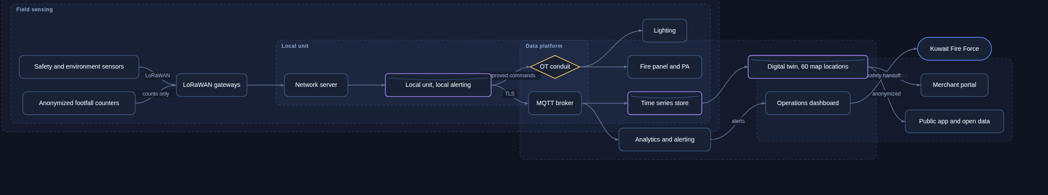
Ali AlEnezi · Site@hotmail.com · 3li.info
03 // ARCHITECTURE
Four layers, from sensing to decisions
Sensing
Edge
Platform
Applications
Fourteen classes on private LoRaWAN. Fire, gas, footfall, noise, air, water, cold chain, humidity, waste, tamper, parking, traffic, heat, lighting. Two vendors per class.
Five gateways, fiber with NB-IoT backup, a redundant edge pair with local rules and 72 hours of autonomy. An OT conduit that passes only signed commands.
A broker with a certificate per device, time series, a digital twin keyed to the map, a CA that signs firmware. Open source core, with an Azure path.
A safety first dashboard, alert routing to Kuwait Fire Force with human confirmation, a merchant portal by zone and hour, public wayfinding and open data.
Smart Souq Al-Mubarakiya · a vision by Ali AlEnezi
Notes:
Hardware, data, information, analytics, made concrete. Note the edge: it keeps life safety working offline.

Slide 5
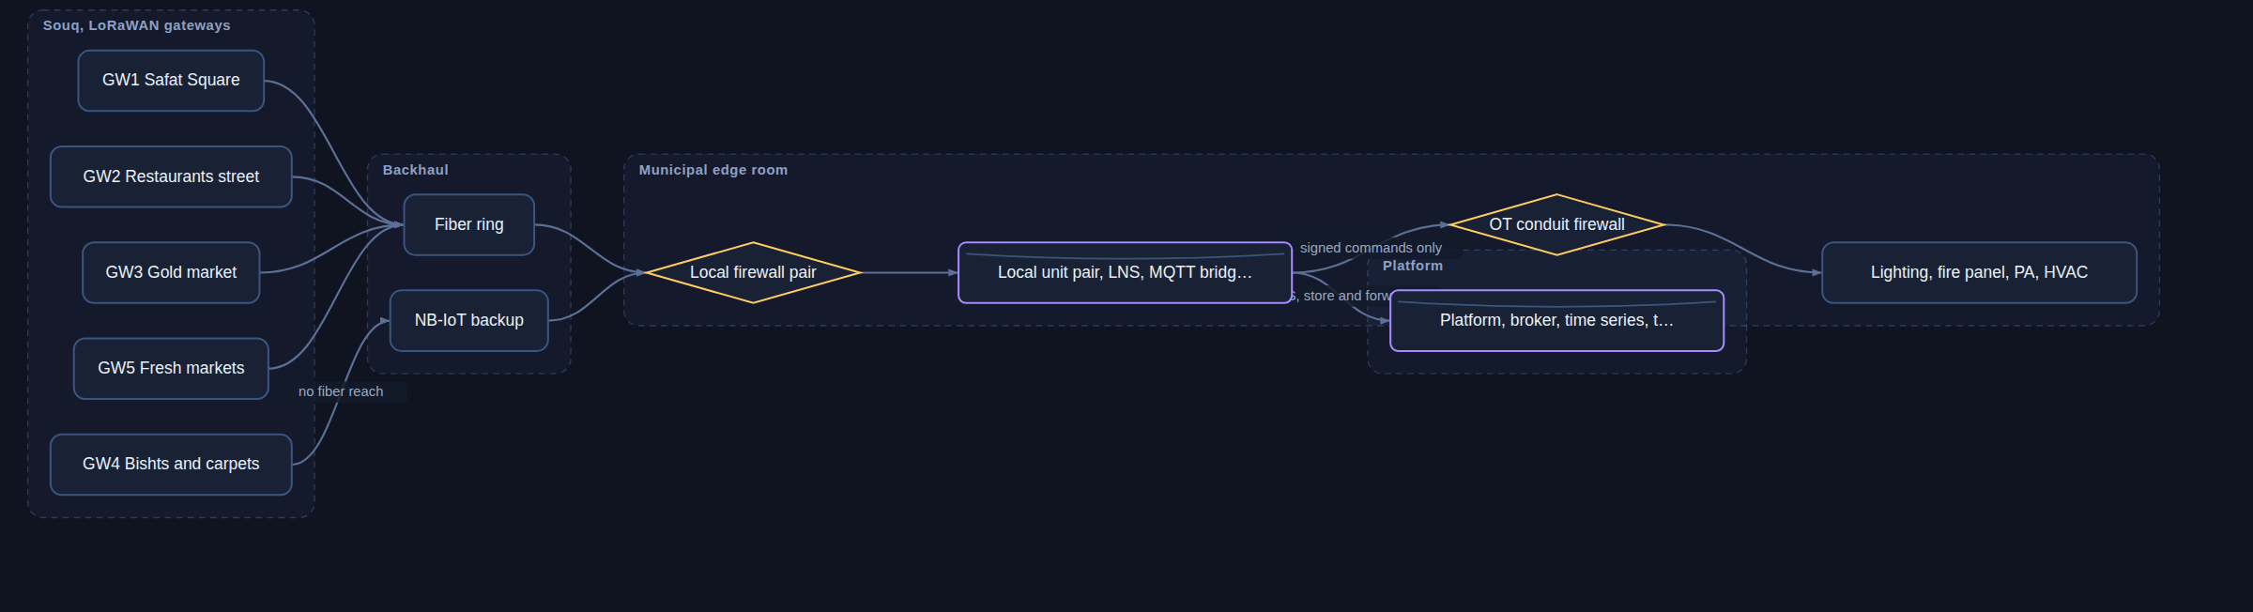
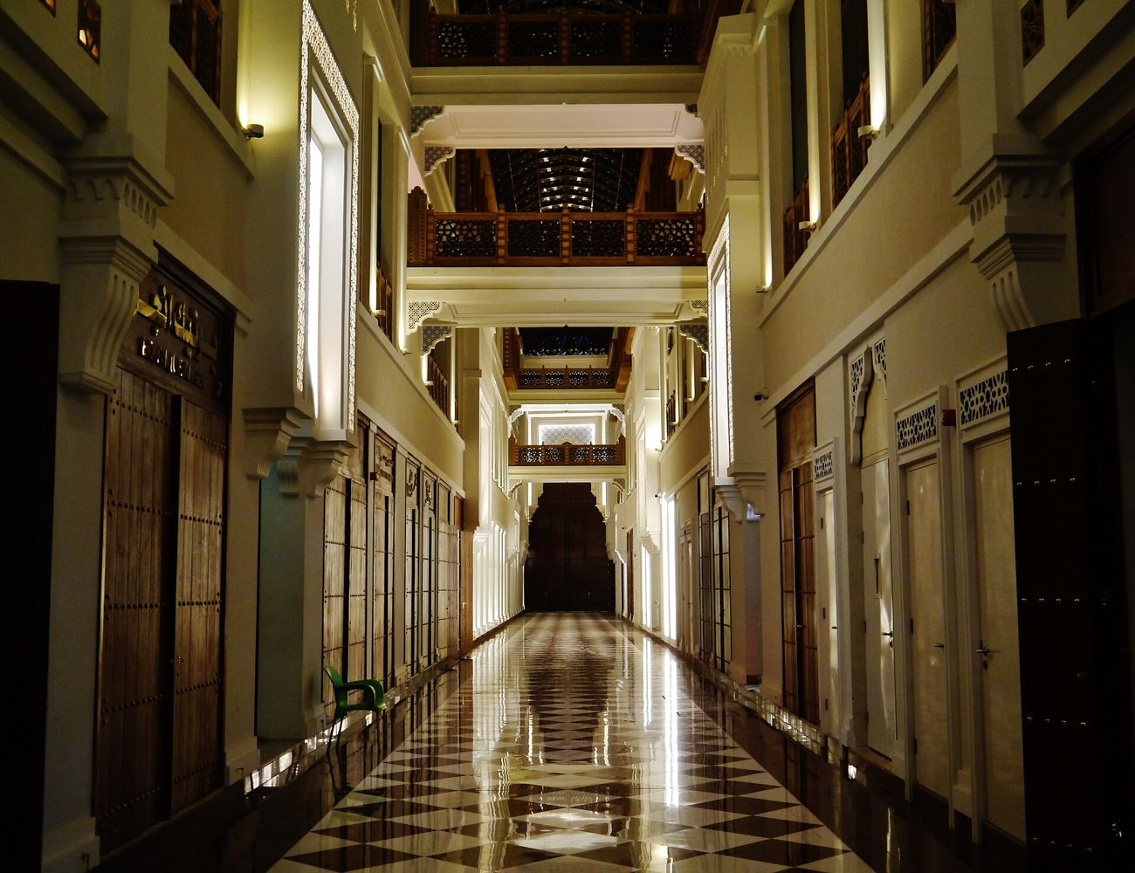
Ali AlEnezi · Site@hotmail.com · 3li.info
04 // NETWORK AND EDGE
The edge keeps people safe when the cloud does not
5 gateways
overlapping LoRaWAN coverage, four on the fiber ring and one on NB-IoT where fiber does not reach
72 hours
store and forward while the platform is unreachable, life safety alerting continues locally
Modes of the edge: connected → degraded, local rules lead → offline, 72 h buffer → recovering, backfill and reconcile. Quarterly drills pull the fiber on purpose to prove it.
Signed only
LoRaWAN 1.0.4 · MQTT 5 over TLS 1.3 · OPC UA, BACnet, DALI · read only Modbus · syslog and CEF to the SOC
the OT conduit accepts commands from an allow list, verified and read back, nothing else
Smart Souq Al-Mubarakiya · a vision by Ali AlEnezi
Notes:
Walk the topology: gateways, backhaul, the municipal edge room, the OT conduit.

Slide 6
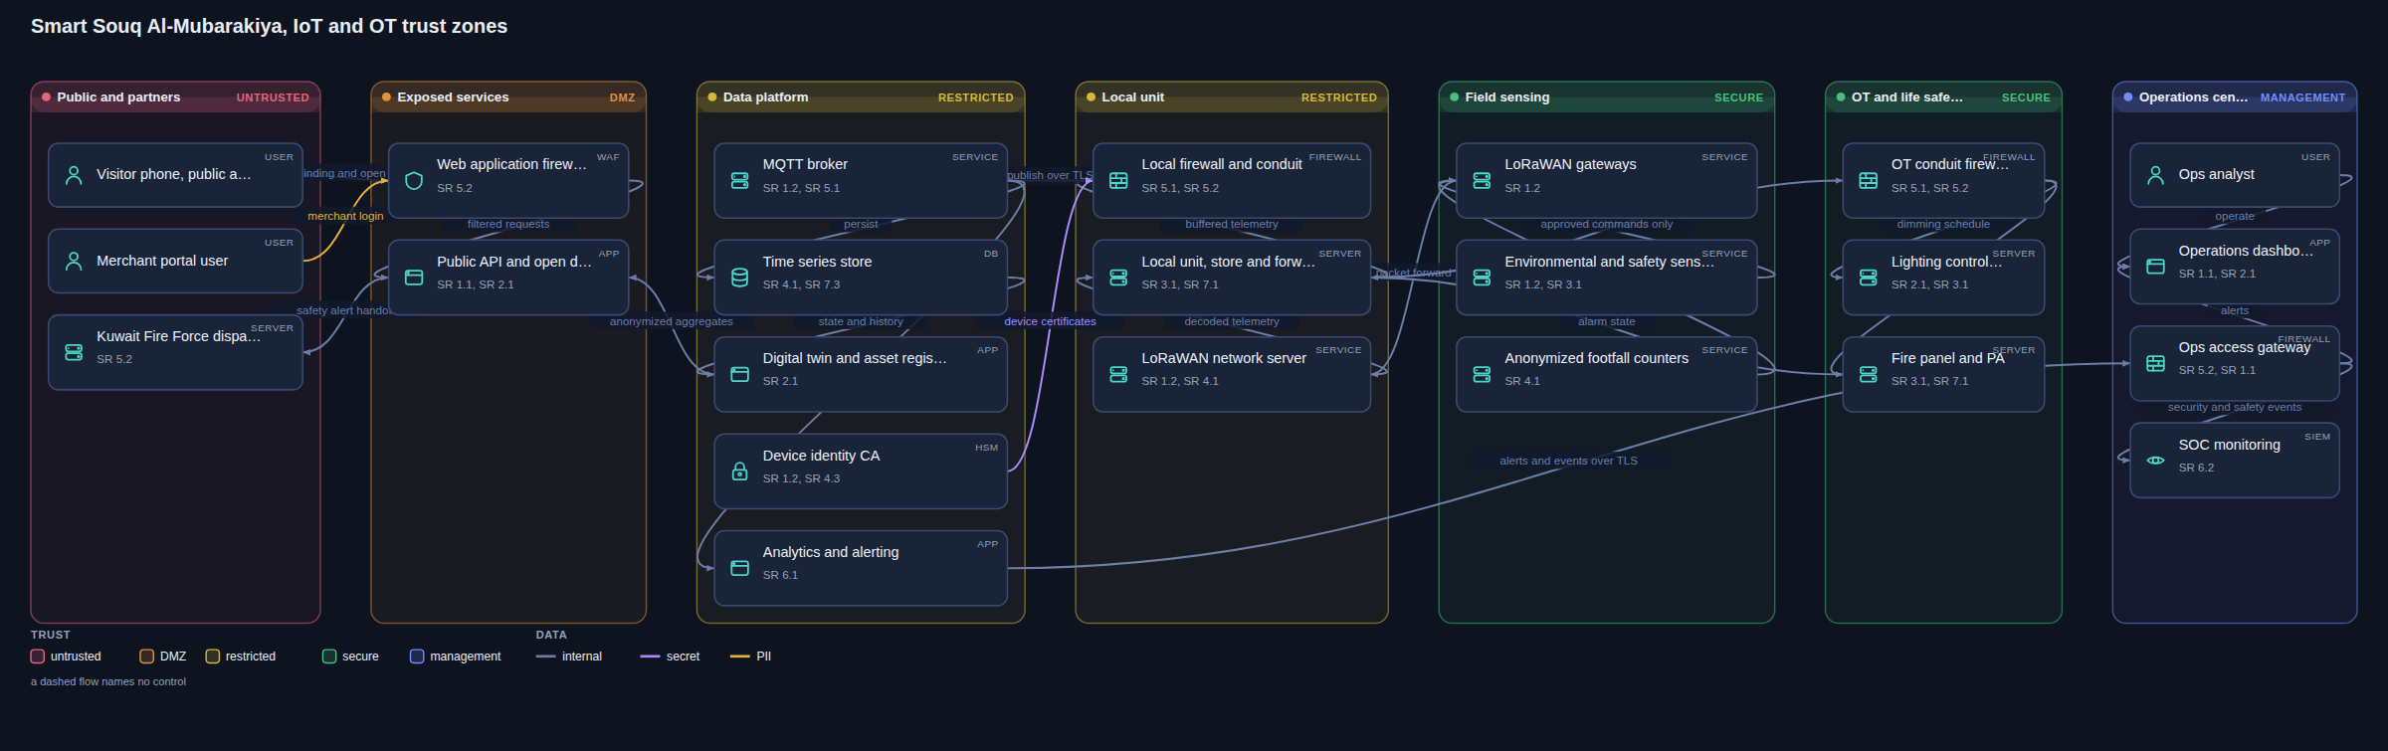
Ali AlEnezi · Site@hotmail.com · 3li.info
05 // SECURITY
Trust zones and conduits, reviewed before anything is built
HISN REVIEW
Certificate per device
Signed commands only
Humans confirm dispatch
nothing to flag · 6 of 6 IEC 62443 areas
no shared keys, no default credentials, unknown devices rejected at the broker
through the OT conduit, second person approval, read back, audited
the system raises, a person confirms Kuwait Fire Force, never automation
Smart Souq Al-Mubarakiya · a vision by Ali AlEnezi
Notes:
The blueprint was drawn and reviewed with Hisn. The review caught two real gaps during design.

Slide 7
Ali AlEnezi · Site@hotmail.com · 3li.info
06 // SENSORS
Fourteen classes, specified for heat and dust
FIRE
GAS
FOOT
HEAT
AIR
WATER
TEMP
Heat and smoke
LPG and CO
Footfall, anonymous
Heat stress, WBGT
Dust and air quality
Water quality
Cold chain
HUMID
WASTE
TAMPER
PARK
TRAFFIC
NOISE
LIGHT
Humidity
Bin fill level
Shutter tamper
Parking bays
Vehicle counts
Noise level
Lighting control
Every device: 60 C or better, IP65 minimum, dust tolerant optics, five year battery or mains with backup, neutral enclosures on non historic fixtures. Pilot about 60 devices, full souq about 400, plus parking bays.
Life safety thresholds, examples: heat above 58 C or rising faster than 8 C per minute, LPG above 10 percent of the lower explosive limit, crowd density above 3 people per square meter at an entrance.
Smart Souq Al-Mubarakiya · a vision by Ali AlEnezi
Notes:
Every class open protocol, two qualified vendors, rated for 60 C and IP65 or better.

Slide 8
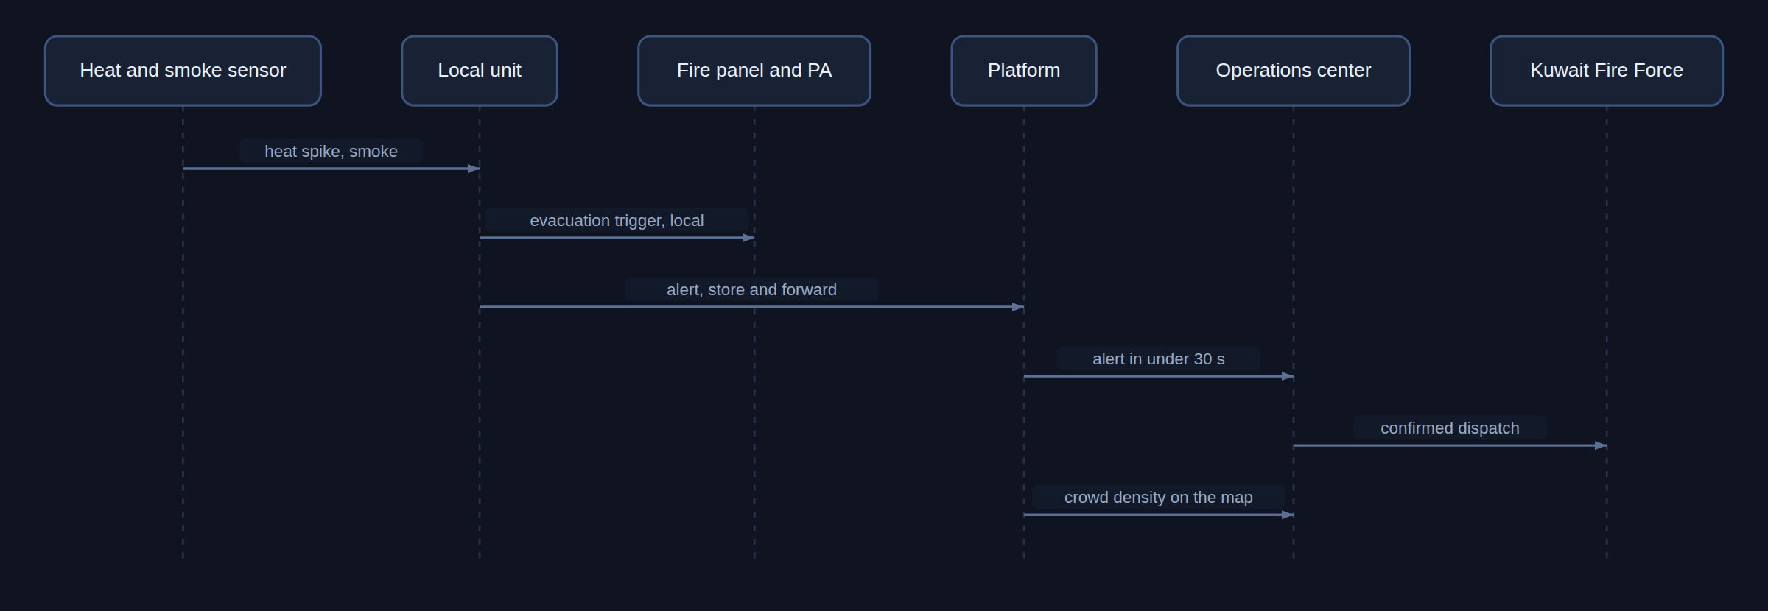
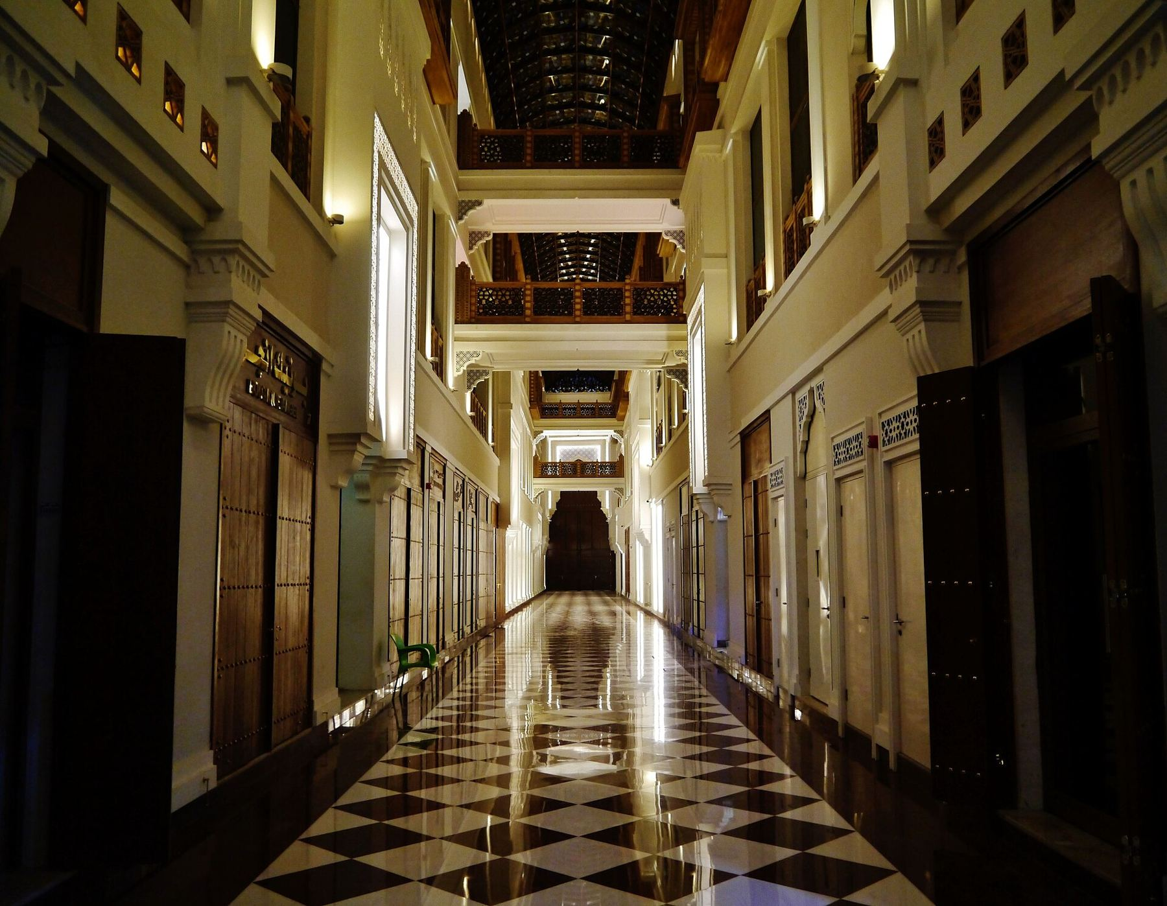
Ali AlEnezi · Site@hotmail.com · 3li.info
07 // A FIRE ALERT, END TO END
From sensor to dispatch in under thirty seconds
1
Heat spike and smoke at the restaurants area
2
The edge triggers the fire panel and PA locally, within seconds
3
Alert reaches the operations center in under 30 s, crowd density on the map
Then the drill continues: crew on site, LPG valve closed, all clear, and 14 audit events written to the SOC. The site runs this as a playable scenario.
4
Ops confirms dispatch to Kuwait Fire Force. Automation never dispatches on its own
Smart Souq Al-Mubarakiya · a vision by Ali AlEnezi
Notes:
Walk through the sequence. Emphasize local triggering and human confirmation.

Slide 9
Ali AlEnezi · Site@hotmail.com · 3li.info
08 // ROADMAP
Five phases, each ending with a decision
0
1
2
3
4
Discover and govern
Pilot one zone
Scale the souq
Intelligence and services
Operate and replicate
6 to 8 weeks
3 to 4 months
6 to 9 months
about 6 months
ongoing
gate: heritage and privacy approvals
gate: review with merchants and Kuwait Fire Force
gate: independent security assessment
gate: privacy review per data product
gate: yearly review
Phase 1, the pilot: the restaurants street, Safat Square, and Gold Parking. Highest fire and crowd risk, most visible win. Two vendors per sensor class so that interchangeable is proven, not promised.
Most of the money sits in Phase 2 civil works and integration, not in sensors. The pilot is the cheapest way to de risk everything after it.
Smart Souq Al-Mubarakiya · a vision by Ali AlEnezi
Notes:
Gates, not dates. Nothing physical goes live without an independent security assessment.

Slide 10
Ali AlEnezi · Site@hotmail.com · 3li.info
09 // WHAT A PILOT WOULD TAKE
An honest picture of a first pilot
Sensing, about 60 devices
Connectivity and edge
Platform and people
24 heat and smoke under the restaurant awnings
12 LPG and CO in the kitchens
8 anonymous footfall counters
4 noise, 3 air, 2 heat stress
1 water quality probe, 4 waste fill
60 parking bay sensors, 1 traffic counter
6 lighting control nodes
3 outdoor LoRaWAN gateways with battery backup, fiber or NB-IoT backhaul
A redundant pair of fanless edge nodes in a municipal room, an edge firewall pair, and an OT conduit firewall
Neutral, non invasive brackets. Nothing touching historic fabric
The open source platform, sized for the whole souq from day one
A device identity CA, dashboards and alerting, fire panel and PA integration accepted with Kuwait Fire Force
A penetration test and a tabletop exercise before anyone calls it done
Ten percent spares, runbooks, and training
Most of the cost goes into civil works and integration, not into sensors.
Smart Souq Al-Mubarakiya · a vision by Ali AlEnezi
Notes:
Grounded numbers for a first pilot. No prices, it is a vision.

Slide 11
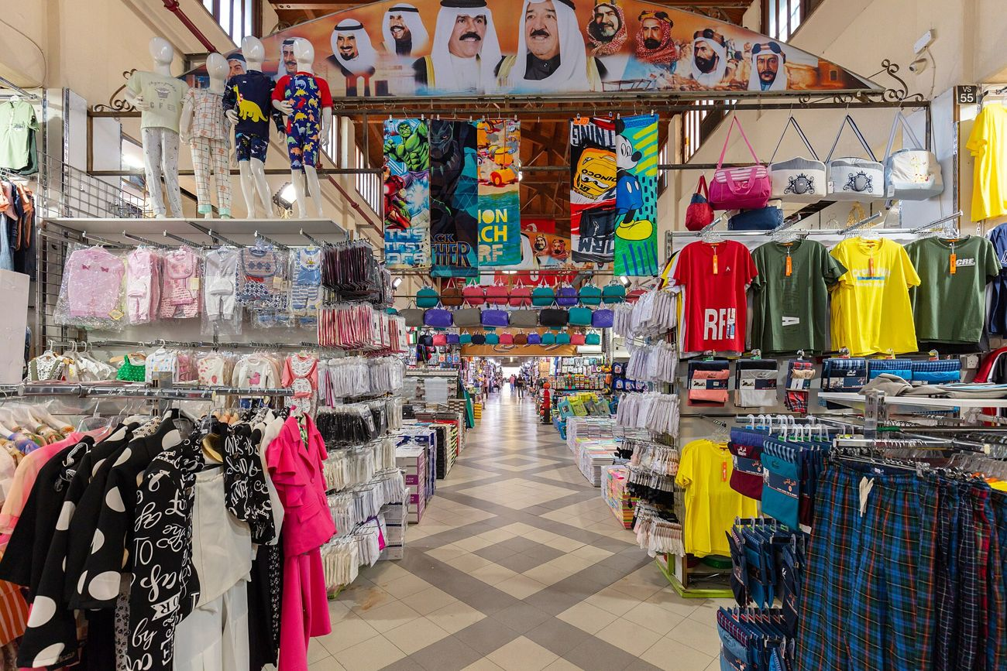
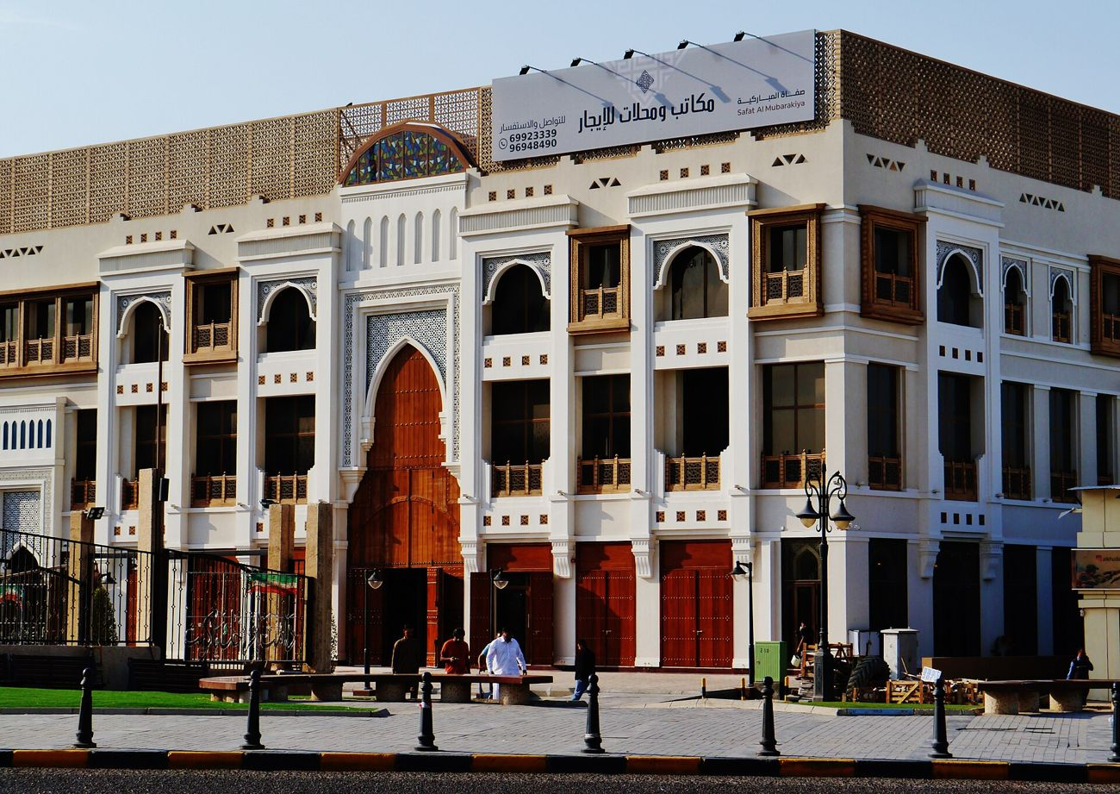
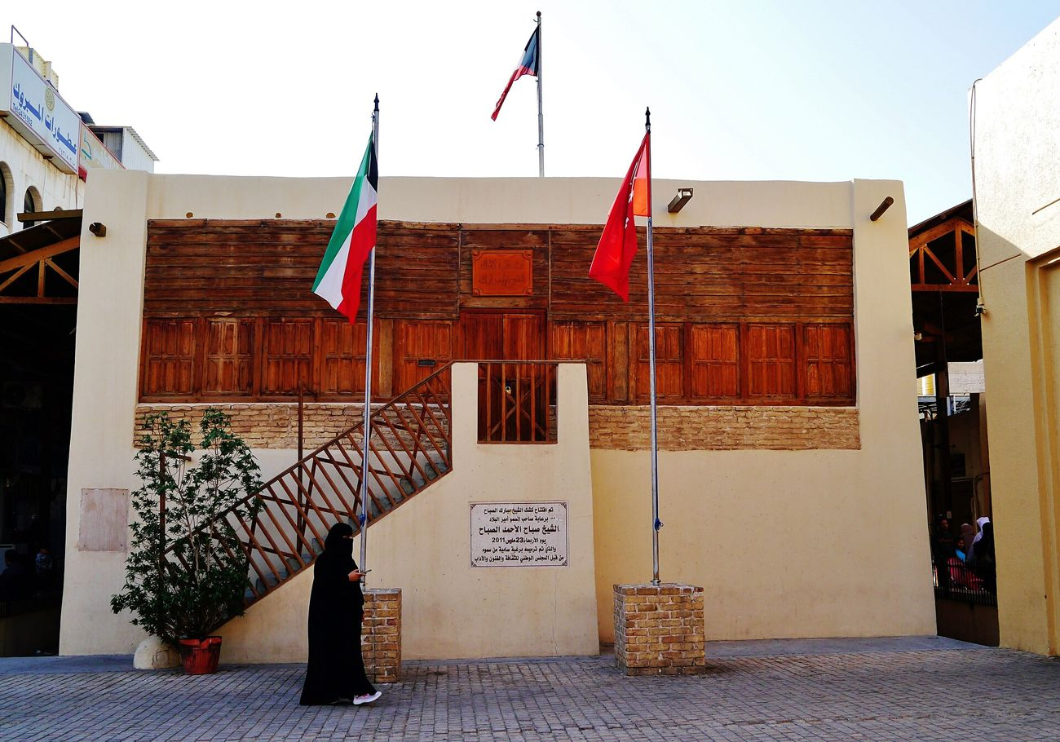
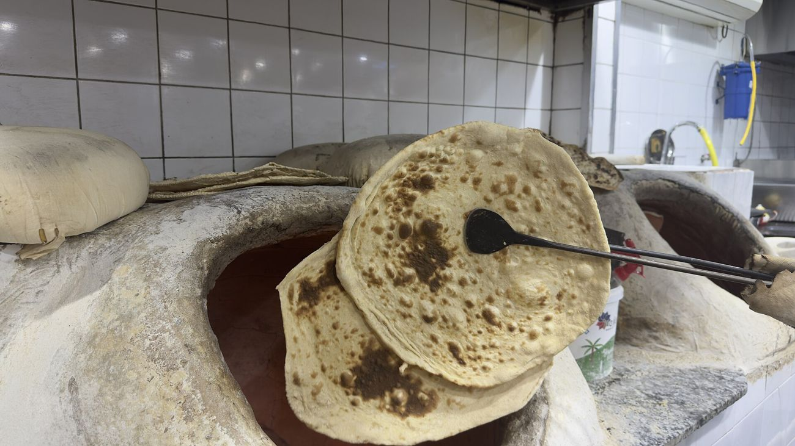
Ali AlEnezi · Site@hotmail.com · 3li.info
10 // THE SOUQ
The place we are protecting
Photographs by Zairon, Diego Delso, and آية سعيد البيطار, Creative Commons via Wikimedia Commons
Smart Souq Al-Mubarakiya · a vision by Ali AlEnezi
Notes:
A pause on the souq itself: the point of all of this.

Slide 12
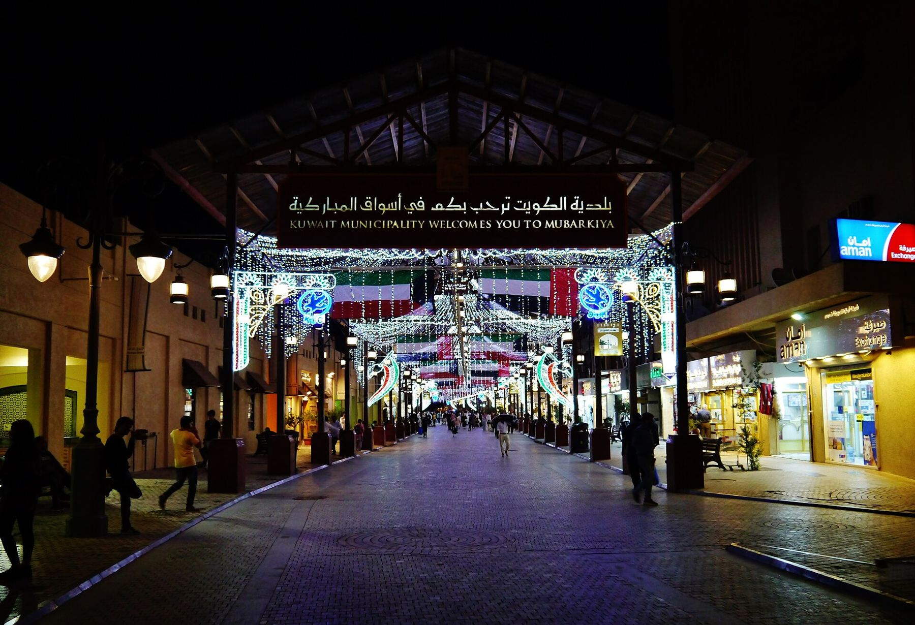
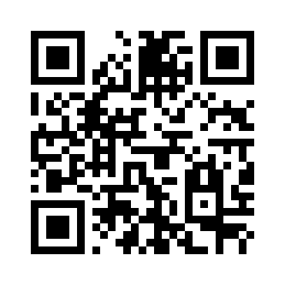
Ali AlEnezi · Site@hotmail.com · 3li.info
This is my dream for Al-Mubarakiya, and I wanted to share it with everyone: that the souq stays as we know and love it, with its soul and its history, and becomes safer through smart technology that works in silence.
A personal vision, shared to read and discuss. The blueprint, the diagrams, the sensor catalog, the registry, the brief, and this deck live on the site.
mubarakiya.3li.info
Ali AlEnezi · 3li.info · linkedin.com/in/alenizi · © 2026, all rights reserved
This work is part of an educational experience. The ideas are owned by Ali AlEnezi. The entities mentioned, Kuwait Municipality, the Ministry of Interior, Kuwait Fire Force, NCCAL, CITRA, the Ministry of Electricity and Water, the Ministry of Commerce, the merchants, and SANS, are mentioned only to elaborate on the ideas and have no real link or connection to this work. SANS is named only as a suggestion for training, and none of its copyrighted material is used here. © 2026 Ali AlEnezi. All rights reserved.
scan to open
Notes:
Close on the dream again.

